Slide 1
Volume 1_Section 1
Chapter 3: Standard and Transmission Based Precaution
IPC and PS for Healthcare Setting in Ethiopia

Slide 2
Chapter Outline
3.1: Overview
3.2: Standard Precaution
3.3: Transmission based precaution
3.4: Empiric use of Transmission Based Precaution

Slide 3
Chapter Objectives
Define standard and transmission based precautions
List the principles of standard precaution
List components of standard precaution
Describe the role of Empiric / Syndoromic use of transmission in prevention of HAI’s
List the components of transmission based precaution
Elucidate the recommended precautions for each route of infection transmission during out break

Slide 4
3.1: Overview

Slide 5
Overview
The guideline issued by the CDC in 1996 involves two level approaches, namely standard precaution and transmission precaution.
Standard Precautions combine the major features of universal precaution and body substance isolation.
Standard Precautions, which apply to all clients and patients attending healthcare facilities on the one hand, and Transmission-Based Precautions which apply primarily to hospitalized patients.

Slide 6
Overview cont’d…
Actually, either approach is too interlinked to be used in separation.
Thus, the relatively specific approach-transmission-based precautions must be used in conjunction with the Standard Precautions.
The basic concept in the implementation the precautions is breaking the disease transmission cycle.
The rationale is that, for transmission to occur within the health care setting, all elements in the disease transmission cycle must be present

Slide 7
3.2: Standard Precaution

Slide 8
Standard Precaution
These are set of guidelines designed to create physical, chemical and mechanical protective barrier between microorganism and person to prevent the spread of infection (the barrier serves to break the diseases transmission cycle).
Example of barriers
  Physical-PPE
  Mechanical barrier –HLD and Sterilization
  Chemical- Antiseptic and Disinfectant

Slide 9
Standard Precaution cont’d…
Standard Precaution is first level precautions.
The aim of standard precautions is to reduce the risk of transmitting micro microorganisms from known or unknown source infection within health care settings.
Applying Standard Precaution while providing patient care is based on the anticipated interaction HCW will have with patient.
They provide a rationale for appropriate utilization of limited IPC resources.

Slide 10
Key Principles of Standard Precaution
Consider every client and patient as potentially infectious or susceptible to infection.
Apply to all patients and clients attending health care facility
Apply to all blood, body fluid, secretion, execration (except sweat), mucous membrane and no intact skin.

Slide 11
  Key Components of Standard Precautions
The components of Standard Precautions create protective barriers for preventing infections in visitors, patients, and HCWs and are based upon the premise that every person (patient, visitor, or HCW) is potentially infectious and susceptible to infection.

Slide 12
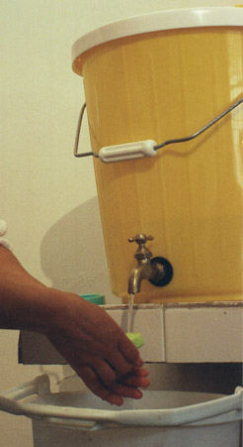
Key Components of Standard Precautions Cont’d…
Hand Hygiene
After touching blood, body fluids, secretions, excretions and contaminated items;
Immediately after removing gloves;
Between patient contacts

Slide 13
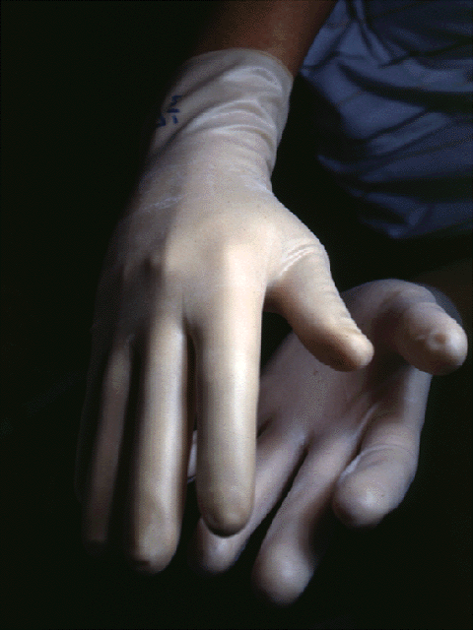
Key Components of Standard Precautions Cont’d…
Wearing Gloves
For contact with blood, body fluids, secretions/excretions or contaminated items;
For contact with mucous membranes and non-intact skin

Slide 14
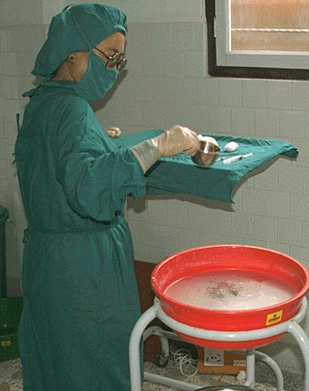
Key Components of Standard Precautions Cont’d…
Gowns/Aprons
Protect skin from blood or body fluid contact
Prevent soiling of clothing during procedures that may involve contact with blood or any body fluids (secretions/excretions)

Slide 15
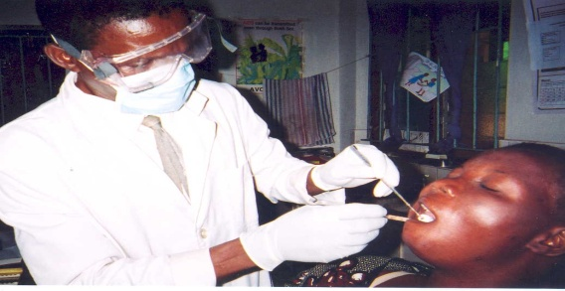
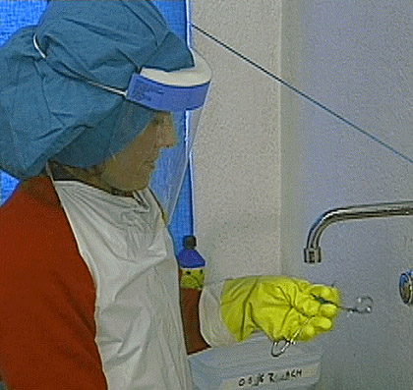
Key Components of Standard Precautions Cont’d…
Masks, Google's and Face shields
Protect mucous membranes of eyes, nose and mouth when contact with blood and body fluids is likely or possible

Slide 16
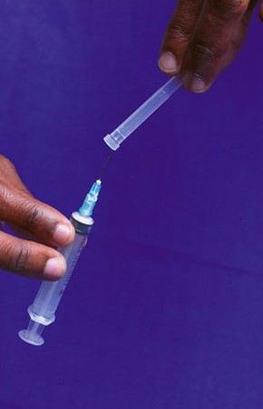
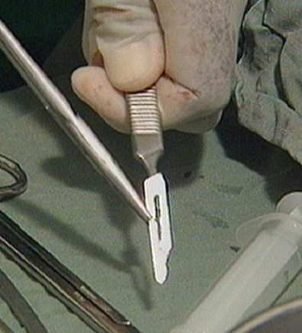
Key Components of Standard Precautions Cont’d…
Sharps and Injection Safety
Avoid recapping, bending, breaking, or hand manipulate used needles; use a one-handed scoop technique only if needed;
Avoid removing used needles from disposable syringes
Place used sharps in puncture-resistant container at point of use
✗

Slide 17
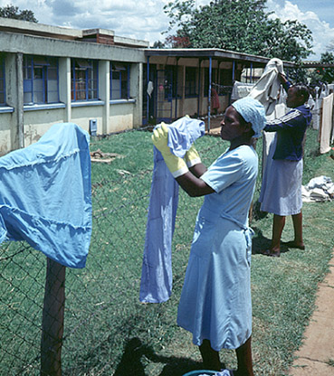
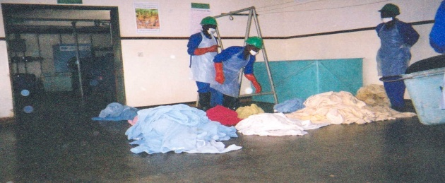
Key Components of Standard Precautions Cont’d…
Processing textile and Laundry
Handle soiled linen to prevent touching of skin or mucous membranes
Do not pre-rinse soiled linens in patient care areas

Slide 18
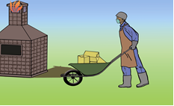
Key Components of Standard Precautions Cont’d…
Healthcare waste Management
Safely dispose of infectious waste materials to protect those who handle them and prevent injury or spread of infection to the community.
HCWM is a key issue to control and reduce HAIs in healthcare facilities (HCF) and to ensure that the environment is well protected.

Slide 19
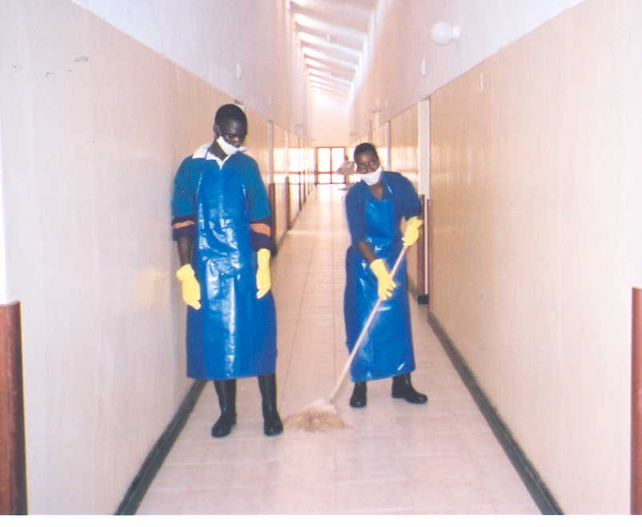
Key Components of Standard Precautions Cont’d…
Environmental Cleaning
Routinely clean noncritical care equipment, instruments, devices, and environmental surfaces.
Clean patient care equipment between each use on patients to prevent cross-contamination between patients.

Slide 20
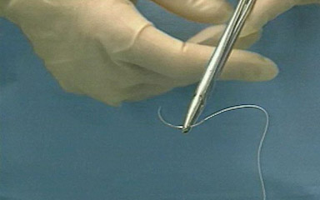
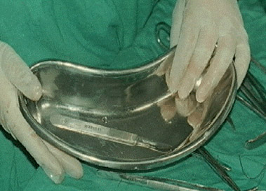
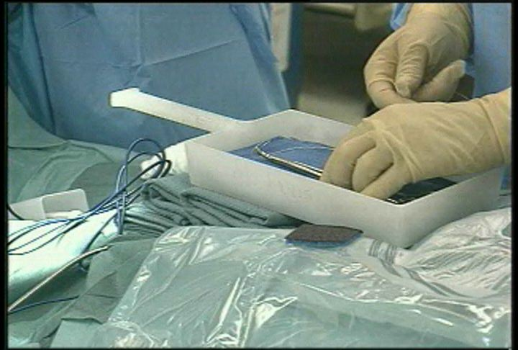
Key Components of Standard Precautions Cont’d…
Safe practice in the OR
Use safe zone ( hand free techniques to pass and receive sharps in the OR)
Use proper handling of sharps

Slide 21
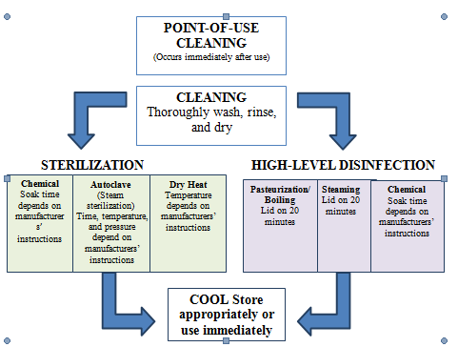
Key Components of Standard Precautions Cont’d…
Instrument Processing
Special attention should be given to proper handling of the instruments and other items to minimize the risk of accidental injury or exposure to blood and other body fluids of the sterile processing staff and to attain high quality end result.

Slide 22
3.3: Transmission Based Precaution

Slide 23
Transmission Based Precaution
Are guidelines designed to reduce the risk of transmitting infections that are spread wholly or partly by airborne, droplet, or contact routes between hospitalized patients and health providers.
Transmission-Based Precautions are for patients who are known or suspected to be infected or colonized with infectious agents including epidemiologically important pathogens which require additional control measures to effectively prevent transmission.

Slide 24
Transmission Based Precaution cont’d…
Since the infective agent is not often known at the time of admission to a healthcare facility, Transmission-Based Precautions are used empirically according to the clinical syndrome and the likely etiologic agents at the time.
Later, the course of management should be modified as soon as the pathogen is identified or a transmissible infectious etiology is ruled out.

Slide 25
  Key Components of Transmission-Based Precaution
Key components of transmission based precaution are
  Airborne precaution
  Droplet precaution
  Contact precaution
Examples
  Airborne: Chicken pox , measles, and tuberculosis
  Droplet: Mumps, rubella, and meningitis (N. meningitides)
  Contact: Enteric pathogens (hepatitis A, echo viruses) and herpes simplex

Slide 26
Key Components of Transmission-Based Precaution cont’d…
For some diseases that have multiple routes of transmission, more than one Transmission-Based Precautions category may be used
When used either individually or in combination, each routes of transmission based precautions are always used in addition to Standard Precautions.
When Transmission-Based Precautions are indicated, efforts must be made to counteract possible adverse effects on patients

Slide 27
Air Borne Precautions
Prevent transmission of infectious agents that remain infectious over long distances (particles which are 5μm or less in size and can remain in the air for several hours and be widely dispersed).
They are recommended for patients with either known or suspected infections that could be transmitted by airborne route.

Slide 28
Air Borne Precautions cont’d…
Characteristics
Particles which are 5μm or less in size and can remain in the air for several hours and be widely dispersed.
Transmission can occur either through airborne droplet nuclei or dust particles containing the infectious microorganisms.
Produced by coughing, sneezing, talking, or by procedures (e.g., bronchoscopy or suctioning).
Special air handling and ventilation are needed to ensure prevention of airborne transmission of infectious agents.
Airborne particles do not land on and contaminate surfaces.

Slide 29
Air borne precautions are:
Patient Placemat
Patients should be placed in airborne infection isolation room (AIIR).
An AIIR is a single-patient room that is equipped with special air handling and ventilation capacity.
If private room not available, place patients in a room with patient having active infection with the same disease, but with no other infection (cohorting).
The staff on duty should check all visitors for susceptibility before allowing them to visit.
Limit movements in and out of the room to HCWs caring for the patient.

Slide 30
Air Borne Precautions cont’d…
Respiratory Hygiene and Cough Etiquette
Cover the mouth and nose when coughing and sneezing and dispose of used tissues in the nearest waste container.
Perform hand hygiene after contact with respiratory secretions and contaminated objects.
Maintain an appropriate distance from and between symptomatic patients, at least 1 meter (3 feet).
Identify persons with symptoms suggestive of acute respiratory illness and teach them to use a surgical mask and practice cough etiquette.

Slide 31
Air Borne Precautions cont’d…
Use of PPE
Wear a particulate respirator such as a fit-tested N95, and conduct a seal check before entering the patient’s room.
In case of chickenpox or measles, no mask is needed for immune persons but susceptible persons should not be allowed to enter the room.
Remove respirator or surgical mask after leaving the room and place in a plastic bag or waste container with tight-fitting lid.
Gown, gloves, and eye protection are not needed for many organisms transmitted exclusively by the airborne route (such as M. tuberculosis, measles) but may be needed when an infectious microorganism is transmitted by multiple routes (e.g., varicella virus).

Slide 32
Air Borne Precautions cont’d…
Patient Transport
Limit transport of patient to essential reasons only.
Alert the department or facility where the patient is being transported so they can prepare to receive a patient on Transmission-Based Precautions.
Use PPE appropriately
  Patients wear a surgical mask
  Cover wounds with appropriate dressings
  Clean and disinfect the wheelchair or coach after transportation.
  Remove PPE and perform hand hygiene once the patient has been

Slide 33
Droplet Precautions
Reduce the risks of transmission of pathogens spread wholly or partly by droplets larger than 5μm in size (e.g. Bordatella pertussis, H. influenza & N. Meningitides, M. pneumonia, flu, mumps, and rubella viruses). Other conditions include Diphtheria, Pertussis, Pneumonic Plague and S. pharyngitis.

Slide 34
Droplet Precautions cont’d…
Characteristics
Transmission of pathogens spread wholly or partly by droplets larger than 5μm in size.
Remain in the air briefly and can travel about 1 meter (3 feet) or less.
requires close proximity or contact between the source and the susceptible host.
Droplets may also land on surfaces and then be transferred by contact transmission.

Slide 35
Droplet Precautions are:
Patient Placement
Private room, door may be left open.
Patients should wear a surgical mask in waiting rooms and when outside of the patient room.
If private room is not available, place the patient in a room with patient having active infection with the same disease, not with other infection.
If neither option is available, maintain over 1 meter (3 feet) spatial separation between patient beds and use of a physical barrier, such as a curtain or divider.

Slide 36
Droplet Precautions cont’d…
Patient Transport
Limit transport of patient to essential reasons only.
Alert the department or facility where the patient is being transported so they can prepare to receive a patient on Transmission-Based Precautions.
Use PPE appropriately
  Patients wear a surgical mask
  Cover wounds with appropriate dressings
  Clean and disinfect the wheelchair or coach after transportation.
  Remove PPE and perform hand hygiene once the patient has been

Slide 37
Droplet Precautions cont’d…
Respiratory Hygiene and Cough Etiquette
Cover the mouth and nose when coughing and sneezing and dispose of used tissues in the nearest waste container.
Perform hand hygiene after contact with respiratory secretions and contaminated objects.
Maintain an appropriate distance from and between symptomatic patients, at least 1 meter (3 feet).
Identify persons with symptoms suggestive of acute respiratory illness and teach them to use a surgical mask and practice cough etiquette.

Slide 38
Droplet Precautions cont’d…
Use of PPE
Wear eye protection and a face mask or face shield, which cover eyes, nose, and mouth completely, before entry into the patient care area
Remove PPE after leaving the patient care area.
If PPE is to be re-used, it must be cleaned and disinfected before each reuse.
Always perform hand hygiene before and immediately after patient care.

Slide 39
Droplet Precautions cont’d…
Cleaning
Ensure that rooms of patients on Droplet Precautions are frequently cleaned and
Disinfected (at least daily and prior to use by another patient). Focus cleaning on surfaces, frequently touched items, and equipment in the immediate patient area
Use gloves, gown and face/eye protection when cleaning patient care equipment and the environment of a patient who has been on Contact Precautions.

Slide 40
Contact Precautions
Patients are placed on Contact Precautions when they have suspected or known infections that are spread directly or indirectly from an infected or colonized individual by touch or contact with the patient or the patient’s environment (surfaces and equipment).
Organisms that require Contact Precautions include cholera, varicella-zoster (shingles); neonatal or mucocutaneous herpes simplex virus; enterovirus meningitis; patients infected or colonized with enteric pathogens, hemorrhagic fever viruses, multidrug-resistant organisms such as and carbapenem-resistant Enterobacteriaceae (CRE); and C. difficile.
Chicken pox is spread both by the airborne and contact routes at different stages of illness. Contact precautions should be implemented for patient with wet or draining infection that may be contagious (e.g. draining abscesses, herpes zoster, impetigo, conjunctivitis, scabies, lice and wound infection).

Slide 41
Contact Precautions cont’d…
Characteristics
Infectious agent transmitted directly from one infected or colonized person to a susceptible person.
Contact is a common way that germs spread in health care facilities.
Infectious agent transmitted indirectly from contaminated inanimate object (e.g., toilet seat, door hand or soiled (feces) bed linen.
Transfer often from hands of health worker (cross-contamination)

Slide 42
Contact Precautions are
Patient Placement
Isolate patients who require Contact Precautions in a single room, if possible.
The door may be left open in this case.
If private room is not available, place the patient in a room with patient having active infection with the same microorganism, not with other infections (cohorting).
In multi-patient rooms, more than one meter (3 feet) spatial separation between patient beds is advised to reduce the opportunities for inadvertent sharing of items between the infected/colonized patient and other patients.

Slide 43
Contact Precautions cont’d…
Use of PPE
Put on a clean, non-sterile gown and gloves upon entering the patient care area; remove and properly discard before exiting the patient room.
Perform hand hygiene immediately after removing PPE
For semi-private or multi-patient rooms, do not use the same PPE between patients.
Remove PPE, perform hand hygiene, and put on new PPE before coming in contact with another patient or patient environment (e.g., bed, patient locker, over-bed table, IV stand etc).

Slide 44
Contact Precautions cont’d…
Hand washing
Involves HCWs cleaning their hands before, after, and at specific moments during patient care and when performing health care tasks.
Wash hands with antimicrobial agent, or use alcohol hand rub before entering room and after removing gloves (if patient has C. difficile diarrhea, need to wash hands with soap and water after removing gloves).
Do not touch potentially contaminated surfaces or items before leaving the room.

Slide 45
Contact Precautions cont’d…
Patient Transport
Limit transport of patients to essential purposes only.
During transport, ensure precautions that are maintained to minimize risk of transmission of organisms (i.e. cover patient with clean linen not what was used on patients’ bed).
Patient care equipment
Use disposable or dedicated patient care equipment (e.g., blood pressure cuffs) and clean and disinfect equipment before reuse on other patients.

Slide 46
Contact Precautions cont’d…
Cleaning
Ensure that rooms of patients on Contact Precautions are frequently cleaned and disinfected (at least daily and prior to use by another patient). Focus cleaning on toilets, frequently touched surfaces, and equipment in the immediate patient area.
Use gloves and gown when cleaning patient care equipment and the environment of a patient who has been on Contact Precautions.
Organisms that form spores (such as norovirus and C. difficile) require cleaning products, such as bleach, that inactivate spores, which are more difficult to destroy than vegetative microorganisms.

Slide 47
3.4: Empiric Use of Transmission Based Precaution

Slide 48
  Empiric/ Syndromic Use of Transmission Based Precaution
Every effort should be made to diagnose the microorganism responsible for infection; however, laboratory diagnosis is not immediately available and not always available.
In these circumstances, precautions must be based on empiric/syndromic findings.
If there is any question about whether a patient without a known diagnosis has a specific infection, implement Transmission-Based Precautions based on the patient’s signs and symptoms until a definitive diagnosis (i.e., laboratory test results) can be made.

Slide 49
Empiric/ Syndromic Use of Transmission Based Precaution cont’d…
Droplet
Severe, persistent cough during periods when pertussis is present in the community
Meningitis (fever, vomiting, and stiff neck)
Hemorrhagic rash
with fever
Generalized rash of unknown cause
Contact
Acute diarrhea in
an incontinent or diapered patient
Diarrhea in adult with recent antibiotic use
Bronchitis or croup
in infants and young children
History of infection with multi drug resistant organisms ?
Abscess or draining wound that cannot be covered
Airborne
Cough, fever, and upper lobe chest findings (dullness and decreased
breath sounds)
Cough, fever, and chest findings in an HIV infected person or person at high-risk for HIV
Rashes (vesicles or pustules) suggestive varicella
Acute respiratory distress syndrome
In all situations, Transmission-Based Precautions must be used in conjunction with Standard Precautions.

Slide 50
Summery
To protect HCWs, patients, and visitors from acquiring infections during health care facility visits, ensure compliance with:
  Standard Precautions for all patients at all times and apply
  Transmission-Based Precautions to all patients with potential or confirmed infections that are transmitted via contact, droplet, and airborne routes.
Standard Precautions, including hand hygiene, are the cornerstone of IPC. They provide the first line of defense in the prevention
Transmission-Based Precautions, including their empiric use, are designed to provide additional protection and reduce the risk of transmissions via airborne, droplet, and contact routes among hospitalized patients and HCWs.

